Slide 1


Verification of realistic regex matching
Marcin Wojnarowski
Supervisors: Dr. Aurèle Barrière, Prof. Clément Pit-Claudel
Examiner: Prof. Nate Foster
Notes:
Can we trust the optimizations of regex matching algorithms?

Slide 2
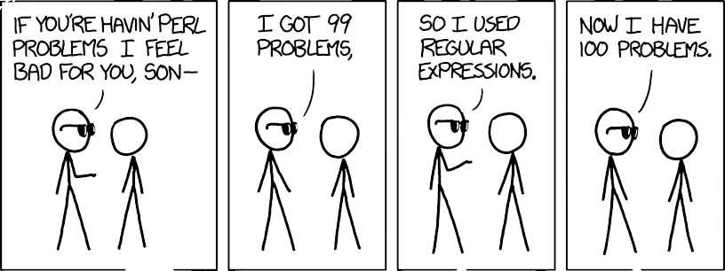
Introduction | 1 of 36
https://xkcd.com/1171

Slide 3
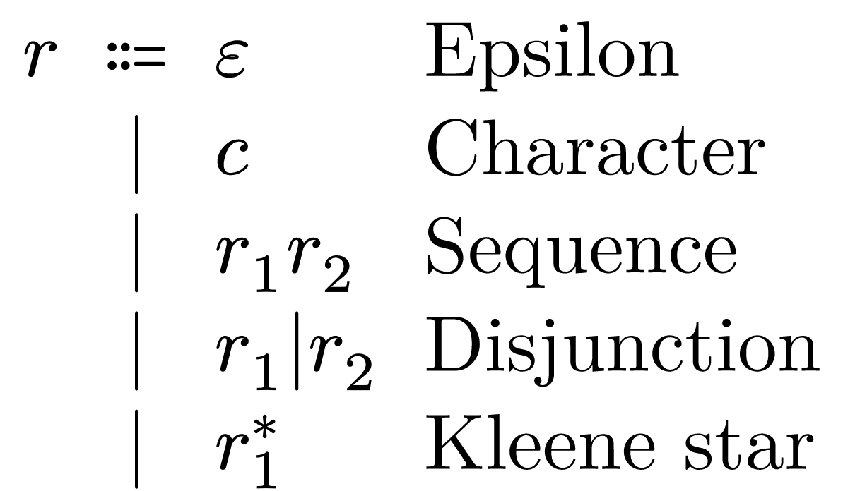
Introduction | 2 of 36
Notes:
How can these 5 cute rules be scary?

Slide 4
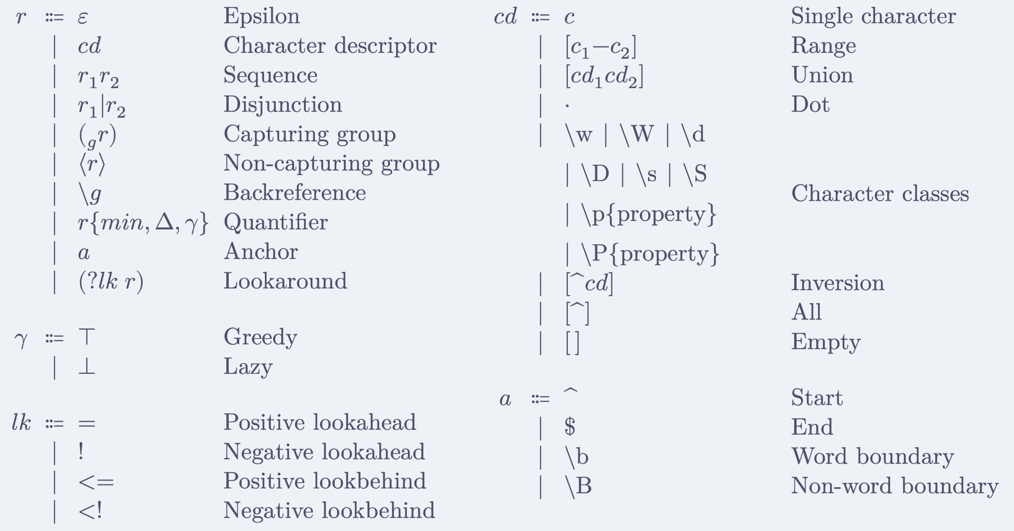
Modern syntax
Introduction | 3 of 36
Notes:
As we know references have no track record of making our lives difficult in computer science

Slide 5
Modern semantics: fundamental questions
Introduction | 4 of 36
Given a regex r and string s
Does r match in s?
Where is the highest priority match?
What are the values of capture groups?
/a|ab/
/a(b|be)w+/
"abxxab"
"ababcccccabeww"

Slide 6
Are backtracking semantics used by anyone?
Introduction | 6 of 36
ECMAScript
C++
Python
Rust
Java
Golang
.NET
Perl
PHP
Dart
Ruby
Raku
Julia
D
Erlang
Yes.
Notes:
Commonly known under the Oracle trademark of "JavaScript"
Safe to say we are dealing with non-toy semantics

Slide 7

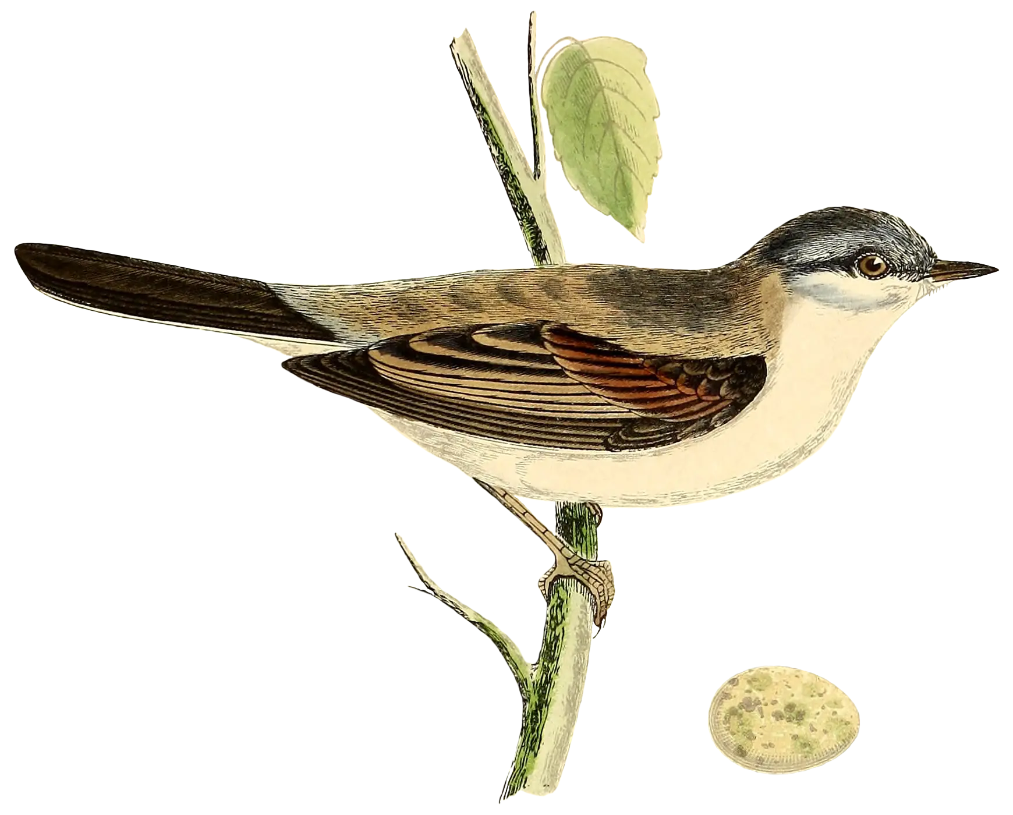

Modern semantics
Introduction | 5 of 36
"A Coq Mechanization of JavaScript Regular Expression Semantics" Noé De Santo, Aurèle Barrière, Clément Pit-Claudel
"Formal Verification for JavaScript Regular Expressions: A Proven Mechanized Semantics and Its Applications" Aurèle Barrière, Victor Deng, Clément Pit-Claudel
Notes:
Warblre: a complete mechanization of ECMAScript regexes

Slide 8
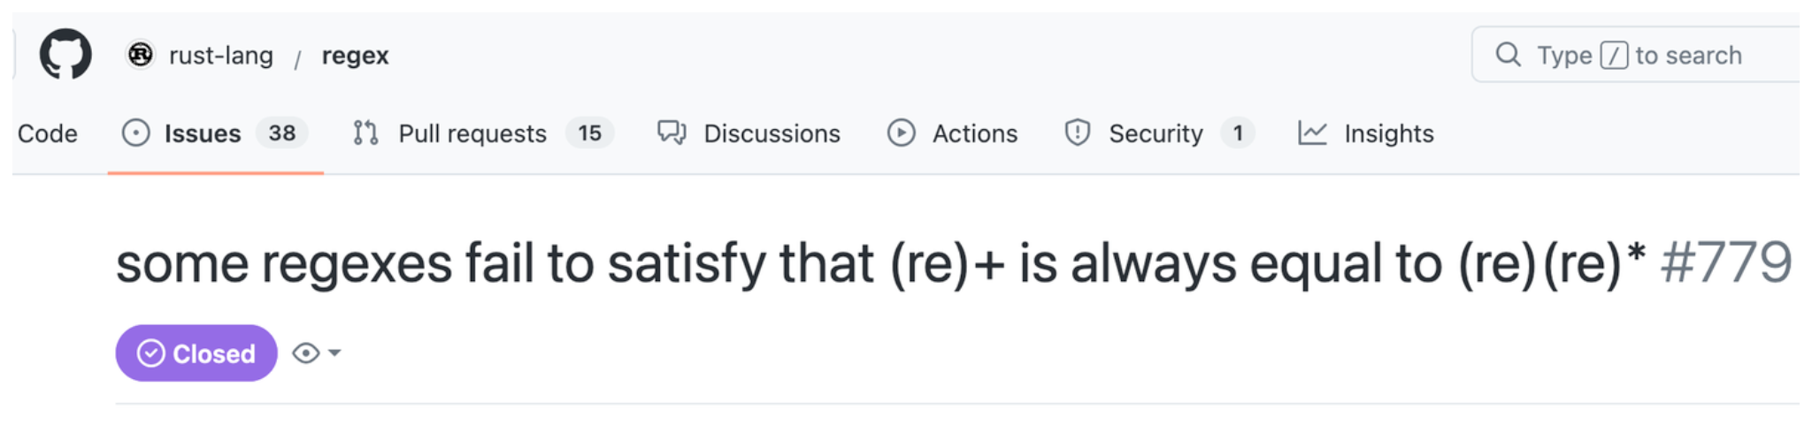

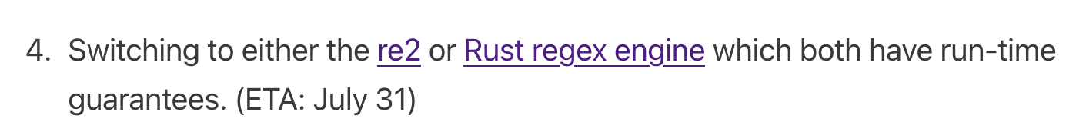

Why formalize?
Introduction | 8 of 36
Notes:
When cloudflare goes down, half of the internet goes down
These libraries do much more than what was formalized

Slide 9
Previous work
Introduction | 7 of 36
Verified: full backtracking semantics in Rocq
Safe: mechanized and proven correct linear-time matching algorithm (PikeVM)

Slide 10
Modern optimizations
Introduction | 9 of 36
Prefix acceleration
Anchored searches
Heuristics
Reverse searches
SIMD
Combining engines
Impossible matches
Literal tries
JIT
Multiple needles searches

Slide 11
Previous work
This work
Introduction | 10 of 36
Verified: full backtracking semantics in Rocq
Safe: mechanized and proven correct linear-time matching algorithm (PikeVM)
3. Realistic: mechanized and proven correct optimizations to speed up matching
Prefix acceleration
Literal extraction
Substring searches
Meta engine
Anchored searches
Impossible matches
Notes:
I will colorcode with magenta my contributions
Bridge the gap between fast dangerous matching algorithms and

Slide 12


Verification of realistic regex matching
+ optimizations
Marcin Wojnarowski
Supervisors: dr. Aurèle Barrière, prof. Clément Pit-Claudel
Examiner: prof. Nate Foster
Notes:
Verification: everything formalized and proven in Rocq
Realistic regex matching: not a toy example

Slide 13
Agenda
Introduction | 11 of 36
PikeVM
Prefix extraction
Prefix acceleration
Meta engine
Notes:
The emphasis will be on prefix acceleration

Slide 14
PikeVM
PikeVM | 12 of 36
Rust
Golang
RE2
V8
Notes:
RE2 which in turn is used by many other libraries
But other languages have reimplemented it

Slide 15
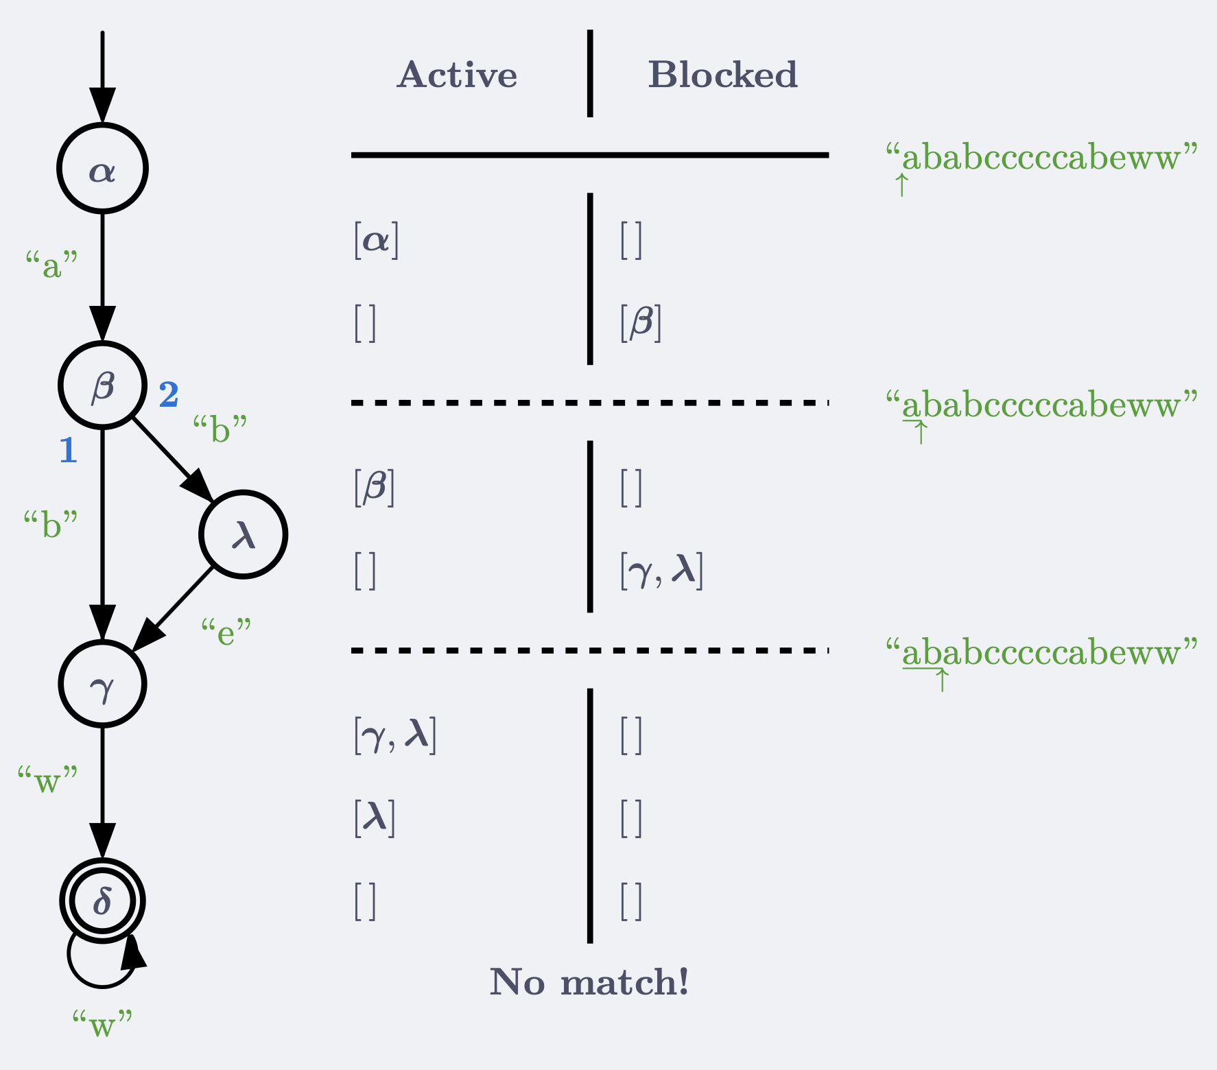

PikeVM | 13 of 36
Notes:
Extended NFA

Slide 16
PikeVM | 14 of 36
"ababcccccabeww"
But… there is a match!
Anchored vs unanchored
Just run the anchored engine at every position
𝑂(|𝑟| ⋅ |𝑠|²) nevermind…

Slide 17
How to make the PikeVM unanchored?
PikeVM | 15 of 36
Before | After
Active = Blocked Blocked = [ ] | Active = Blocked ++ [𝜶] Blocked = [ ]
Notes:
Let's make this extension efficient
We use the information about regex literals to speed this up

Slide 18
Prefix extraction
Prefix extraction | 16 of 36

Slide 19
Prefix of regexes
Prefix extraction | 17 of 36
prefix(
) = "ab"...
Theorem: all matches must start with prefix
Contrapositive: if at some position we do not have prefix, a match cannot exist there

Slide 20
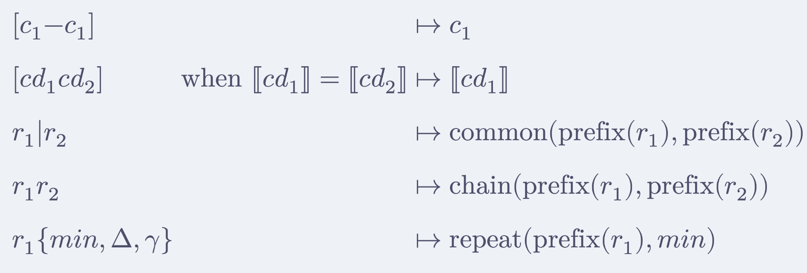
Some supported constructs
Prefix extraction | 18 of 36
Formalized prefix extraction analysis and its connection to matching

Slide 21
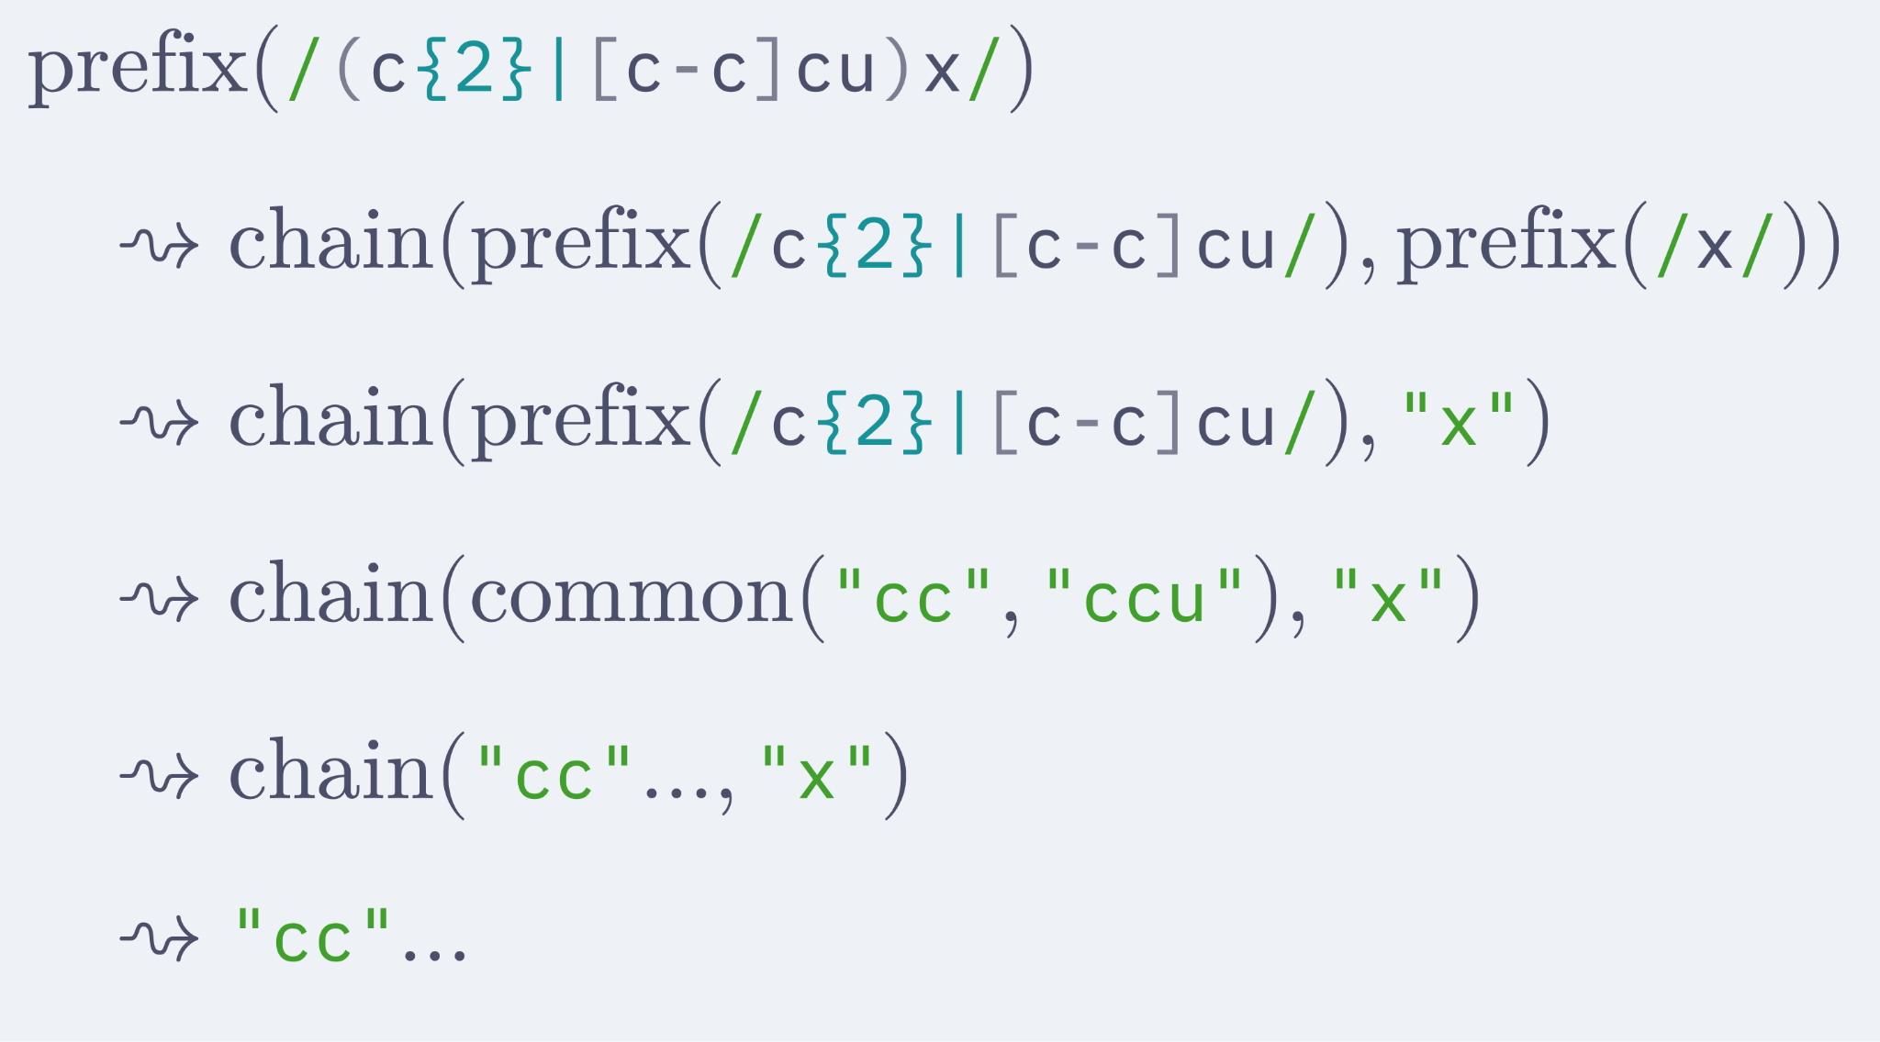
Example prefix extraction
Prefix extraction | 19 of 36

Slide 22
Prefix acceleration
Prefix acceleration | 20 of 36
Leveraging prefixes of regexes to accelerate over parts of the string.

Slide 23
Unanchored PikeVM
Prefix acceleration | 21 of 36
Keep a counter of when next the prefix will match
Attach the 𝜶 state
Use the counter together with the Contrapositive theorem of prefix extraction to optimize

Slide 24
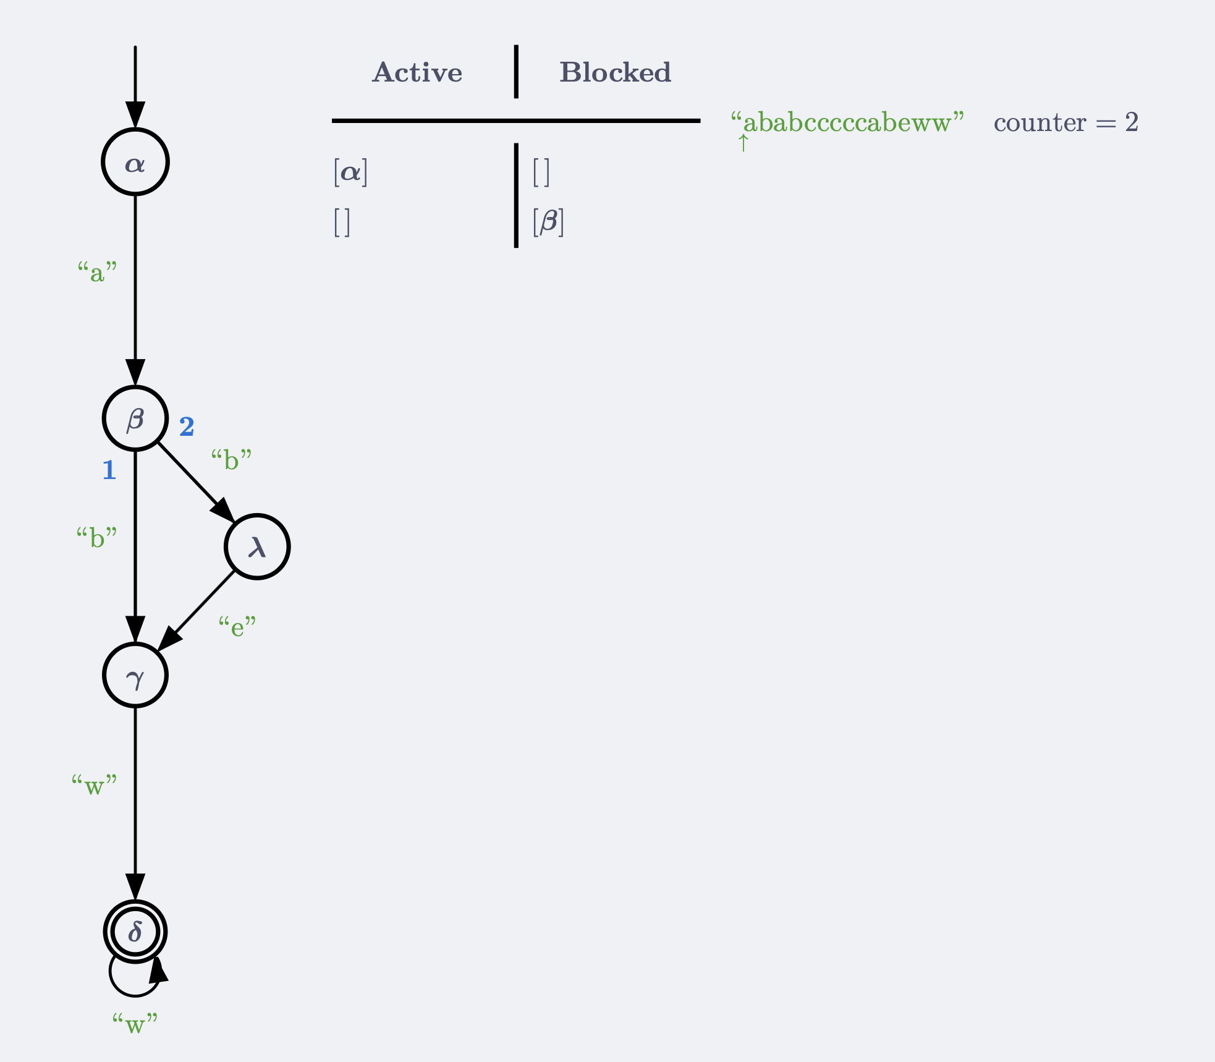
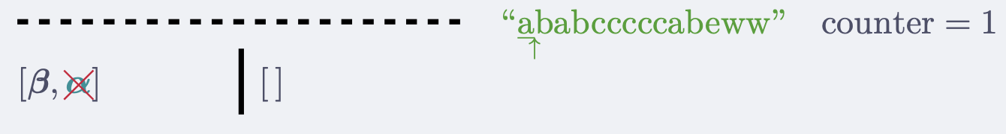
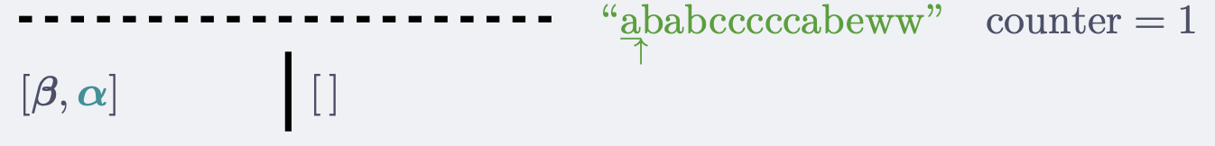
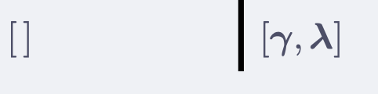
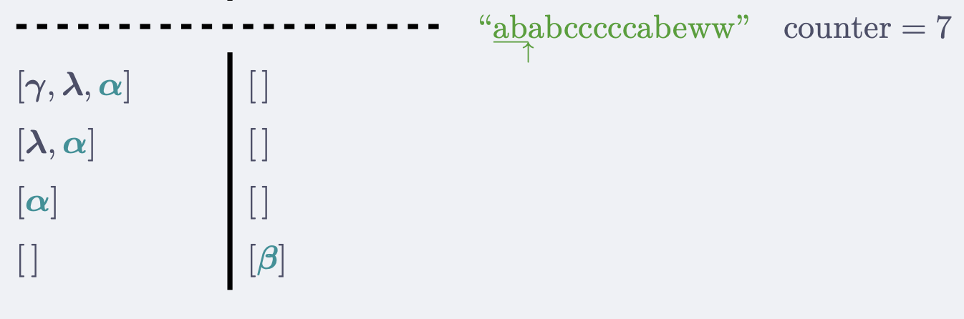
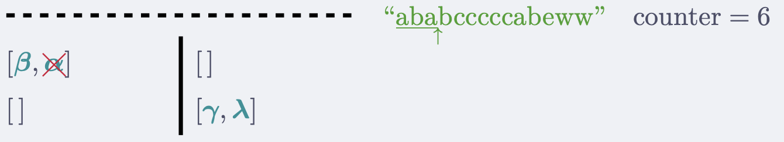
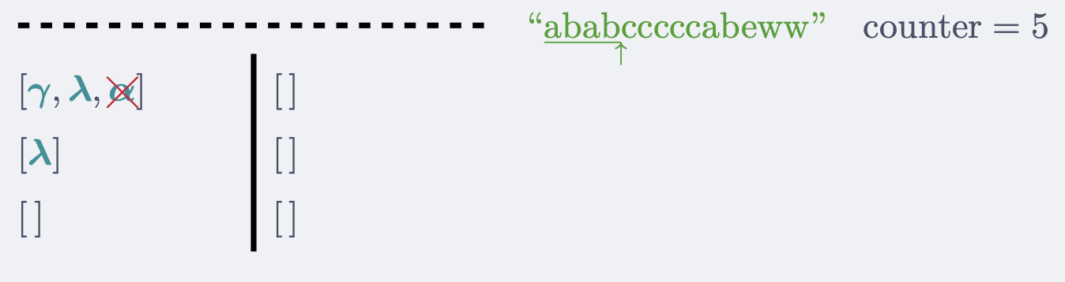
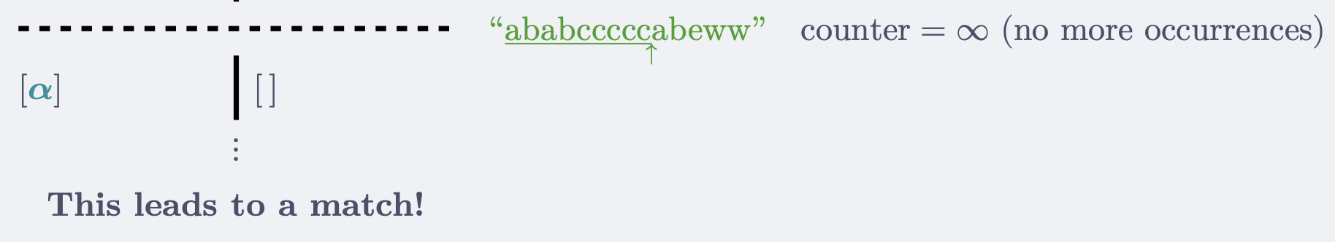
Prefix acceleration | 22 of 36
Filtering
Filtering
Filtering
Acceleration

Slide 25
Evaluation of the unanchored PikeVM
Prefix acceleration | 23 of 36
Rust's regex library + rebar regex benchmark suite²
Acceleration: up to 600× speed up!
Filtering (novel): up to 20× speed up!
Analyzed a corpora of 1,5 million regexes³
66% of those have a meaningful prefix
The most important optimization
Verified unanchored PikeVM, well known acceleration, novel filtering
²https://github.com/LindenRegex/rebar/tree/mw/prefix-acc-cmp
³https://doi.org/10.1145/3236024.3236027
Notes:
Rebar tries to model real-world regex usage

Slide 26
Unanchored PikeVM verification challenge
Prefix acceleration | 24 of 36
The existing proof pipeline is large, we want to reuse as much as possible.
Success:
anchored PikeVM ⇔ unanchored PikeVM with counter = ∞
Notes:
Getting Qed was only part of the goal
This has been successful. The unanchored pikevm is just the pikevm with the counter initialized
Let's see what we need to bridge to prove the correctness

Slide 27
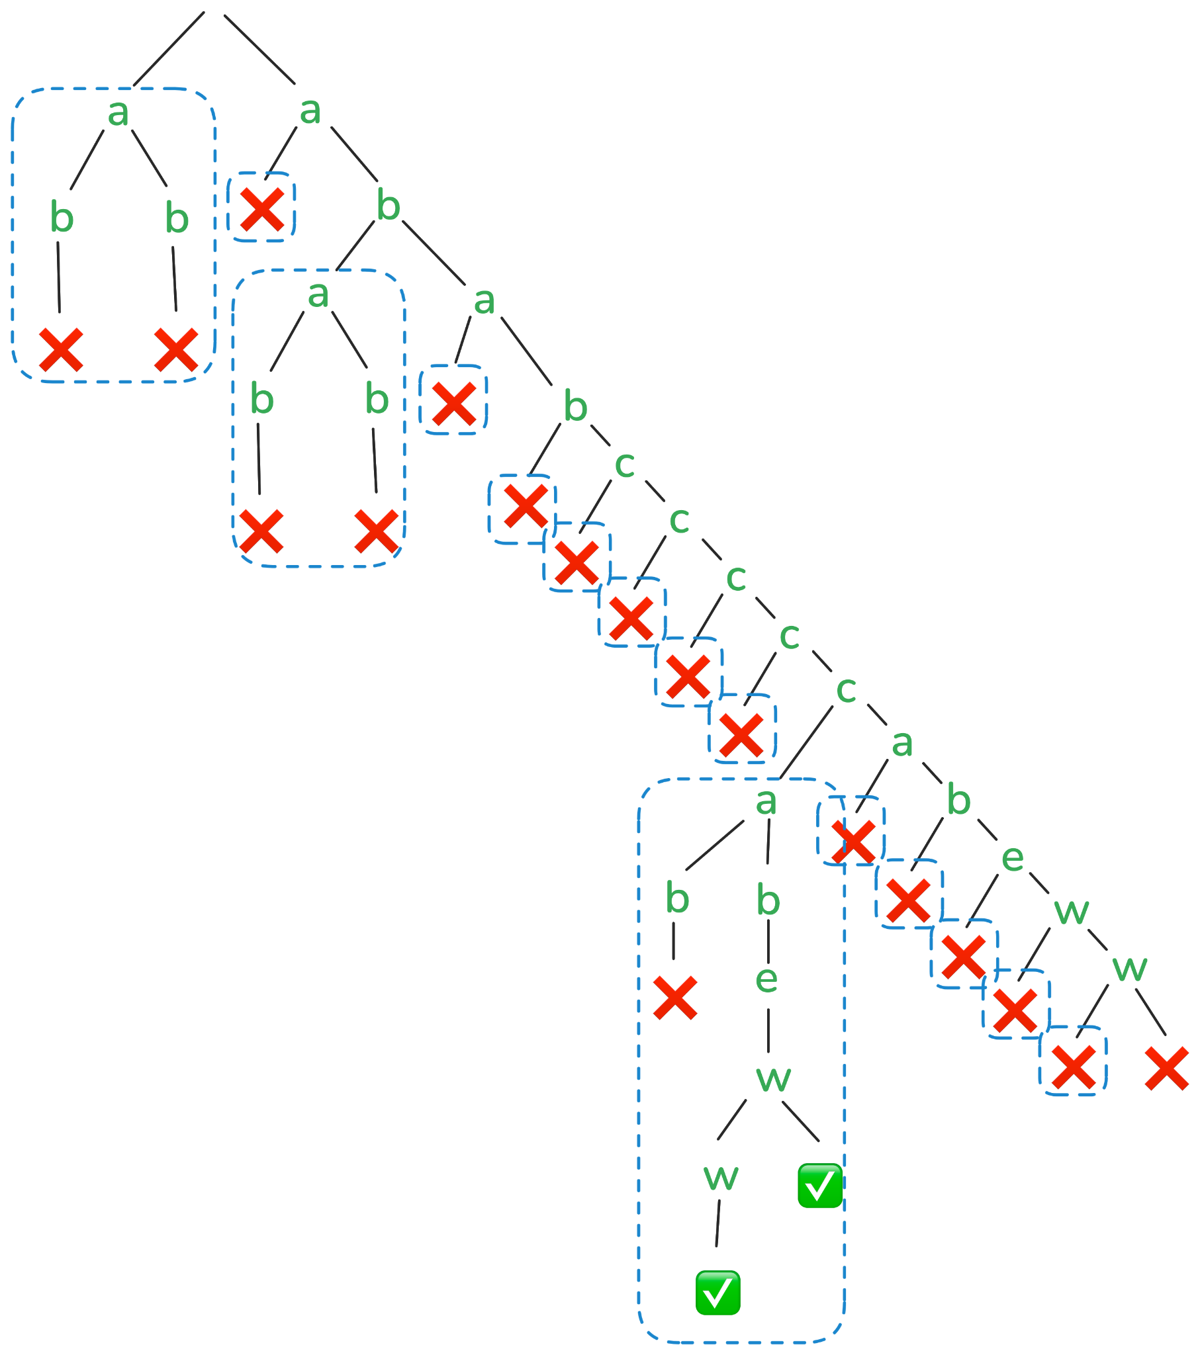

Backtracking trees
Prefix acceleration | 25 of 36
Tree of over "ababcccccabeww"

Slide 28
Existing PikeVM proof pipeline
Prefix acceleration | 26 of 36
PikeVM(/r/, inp)
=
firstLeaf(tree(/r/, inp))
=
=
PikeTree(tree(/r/, inp))
PikeVM state at some position ~ PikeTree subtree
Notes:
How did I approach it to extend it to our new PikeVM?

Slide 29
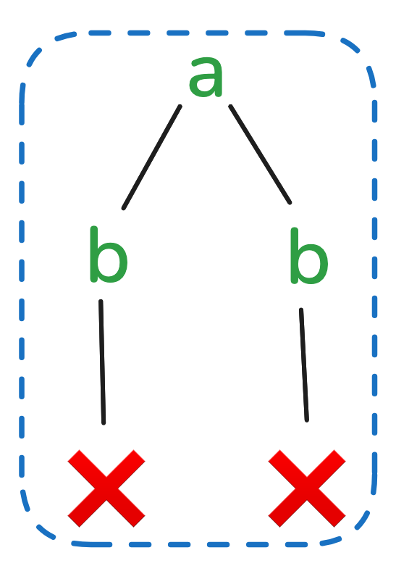
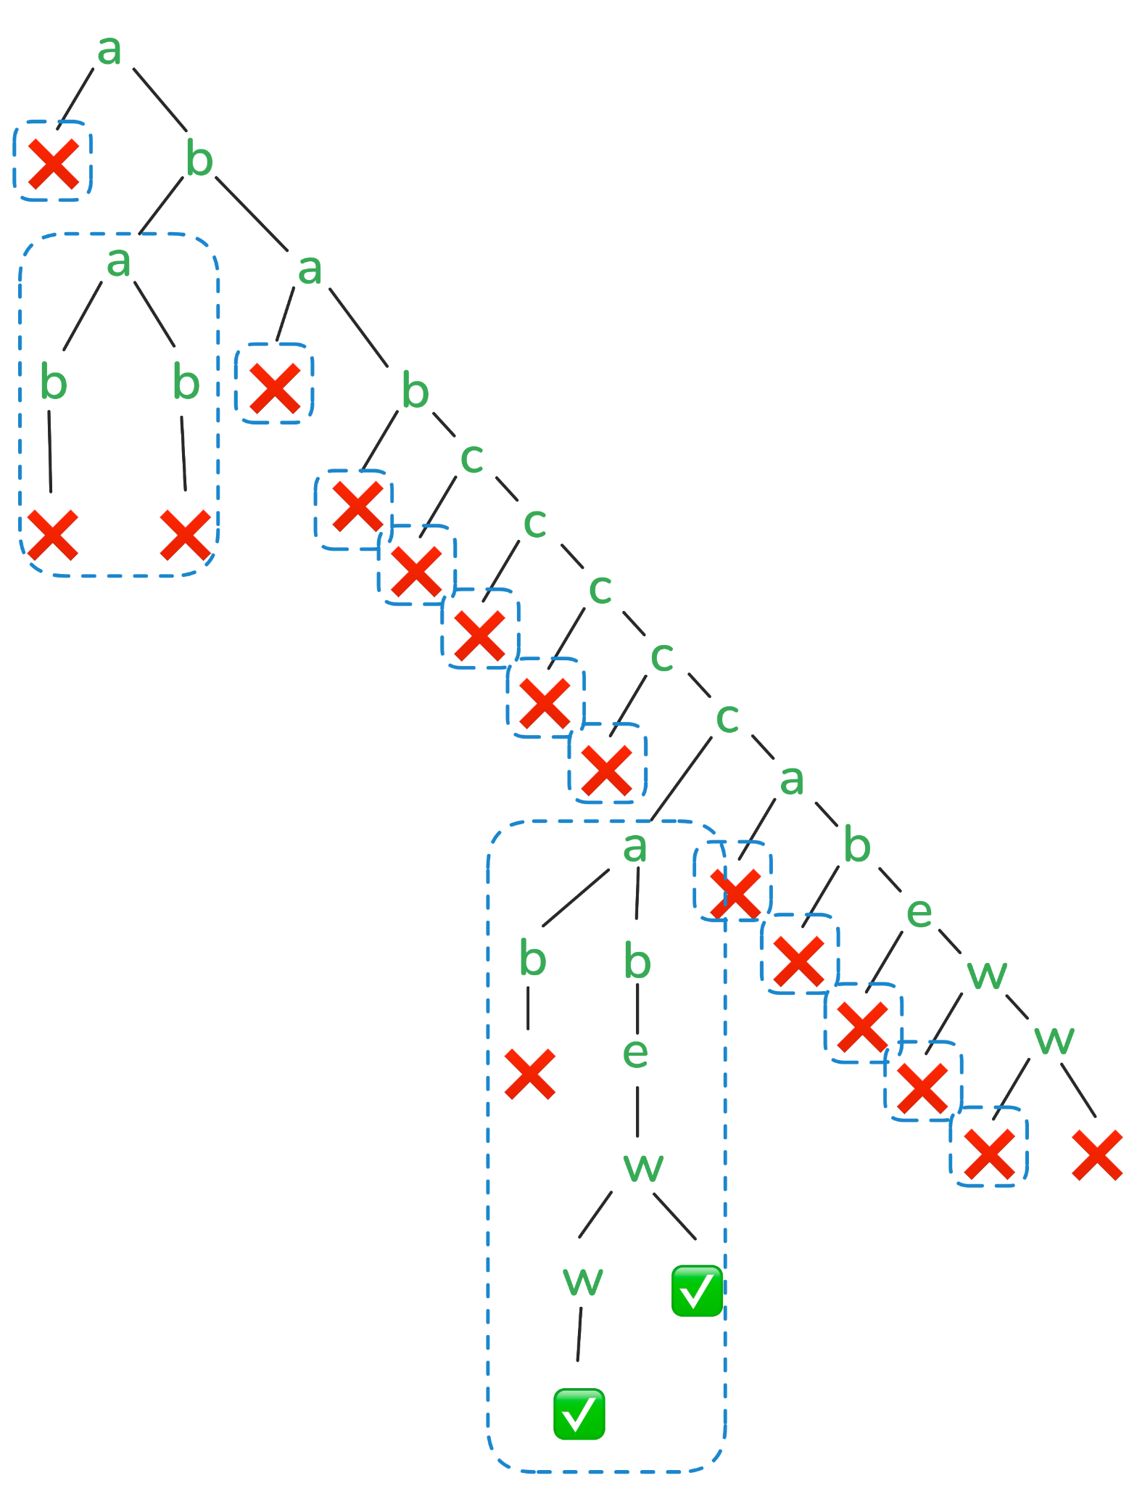

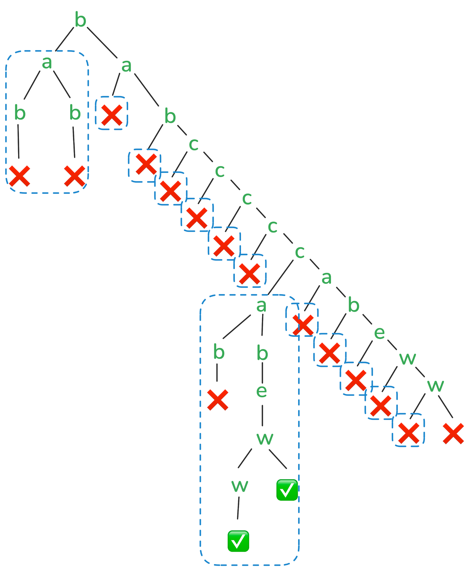
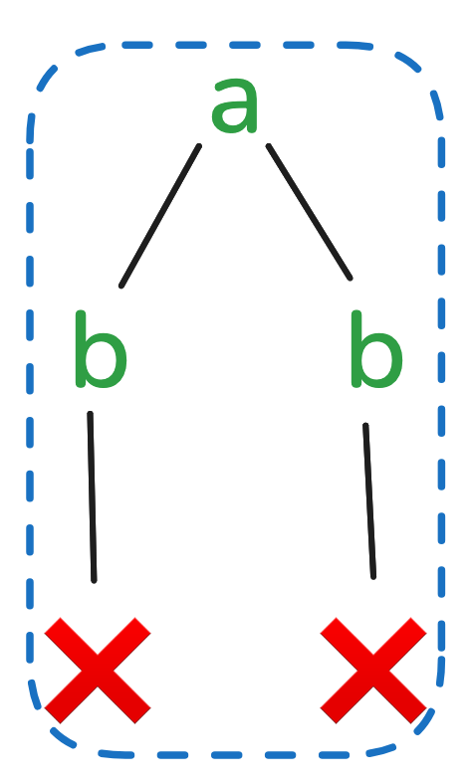
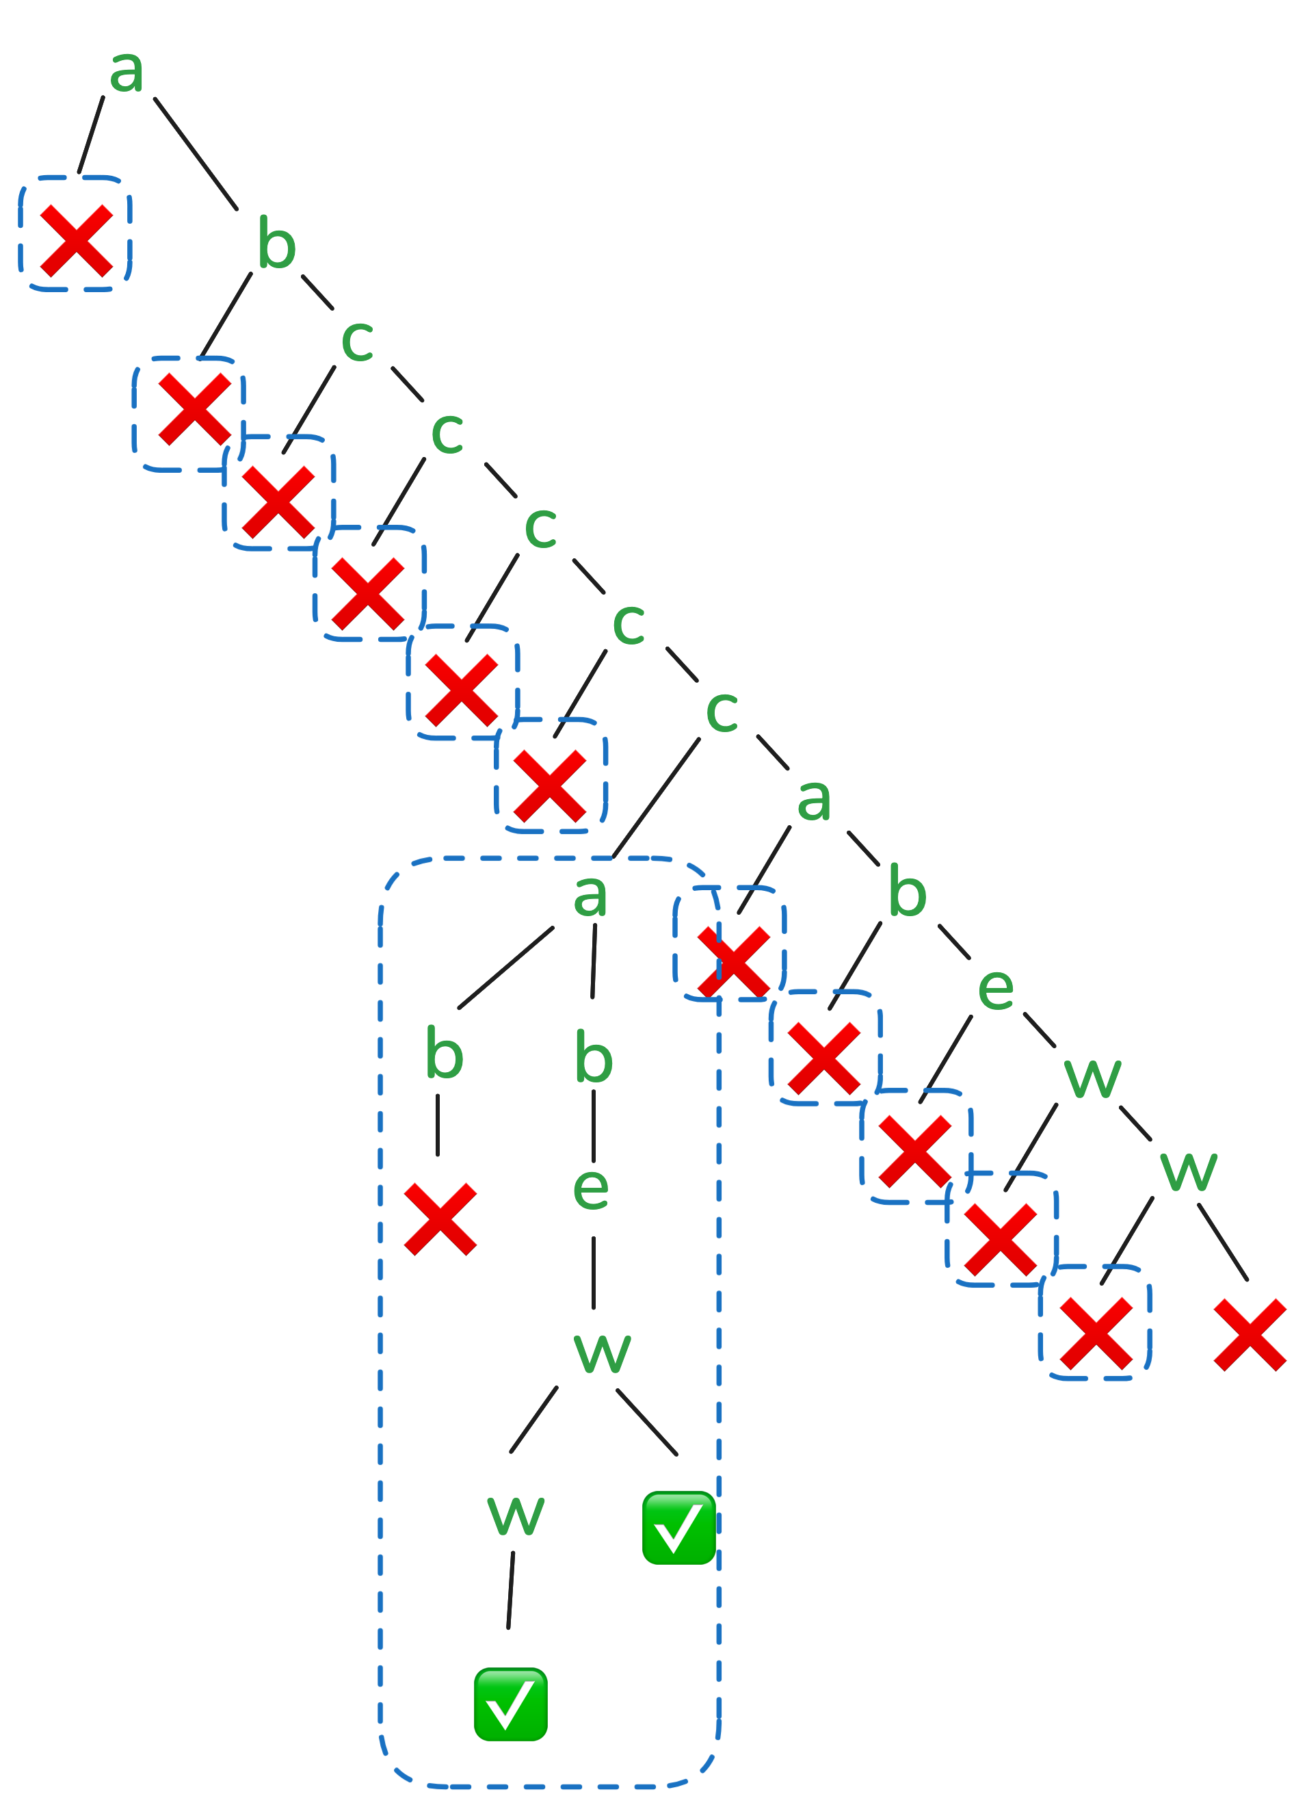
Unanchored PikeTree
Prefix acceleration | 27 of 36
Active
Future
Notes:
First we need to make the PikeTree unanchored

Slide 30
Unanchored PikeTree
Prefix acceleration | 28 of 36
Filtering: don’t append subtree with no matches
Acceleration: skip subtrees with no matches
PikeVM counter = n ~ next n subtrees of PikeTree have no matches
Proof of correctness of unanchored PikeVM with prefix acceleration

Slide 31
Meta engine
Meta engine | 29 of 36
Engines
PikeVM
Memoized backtracker
One-pass DFA
Lazy DFA
…
Optimizations
Prefix acceleration
Substring searches
(Reverse) anchored
Heuristics
Impossible regexes
…

Slide 32
PikeVM
MemoBT
Meta engine | 30 of 36
𝑂(|𝑟| ⋅ |𝑠|) runtime
𝑂(|𝑟|²) memory
~2× faster¹
𝑂(|𝑟| ⋅ |𝑠|) memory
Heuristic for picking the most suitable engine and bridging their functionality
¹https://burntsushi.net/regex-internals
Notes:
Both already implemented

Slide 33



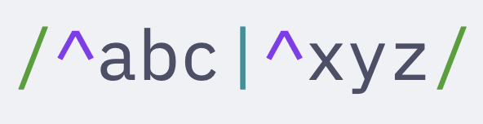


Anchored searches (23%)
Meta engine | 31 of 36
❌ ":2026-02-05"
✅ "2026-02-10"
Anchored
Not
Just try to match the regex once at the beginning of the string.
Theorem: Matching not at the beginning of the string always fails for anchored regexes
Notes:
- useful for validati ng user input

Slide 34
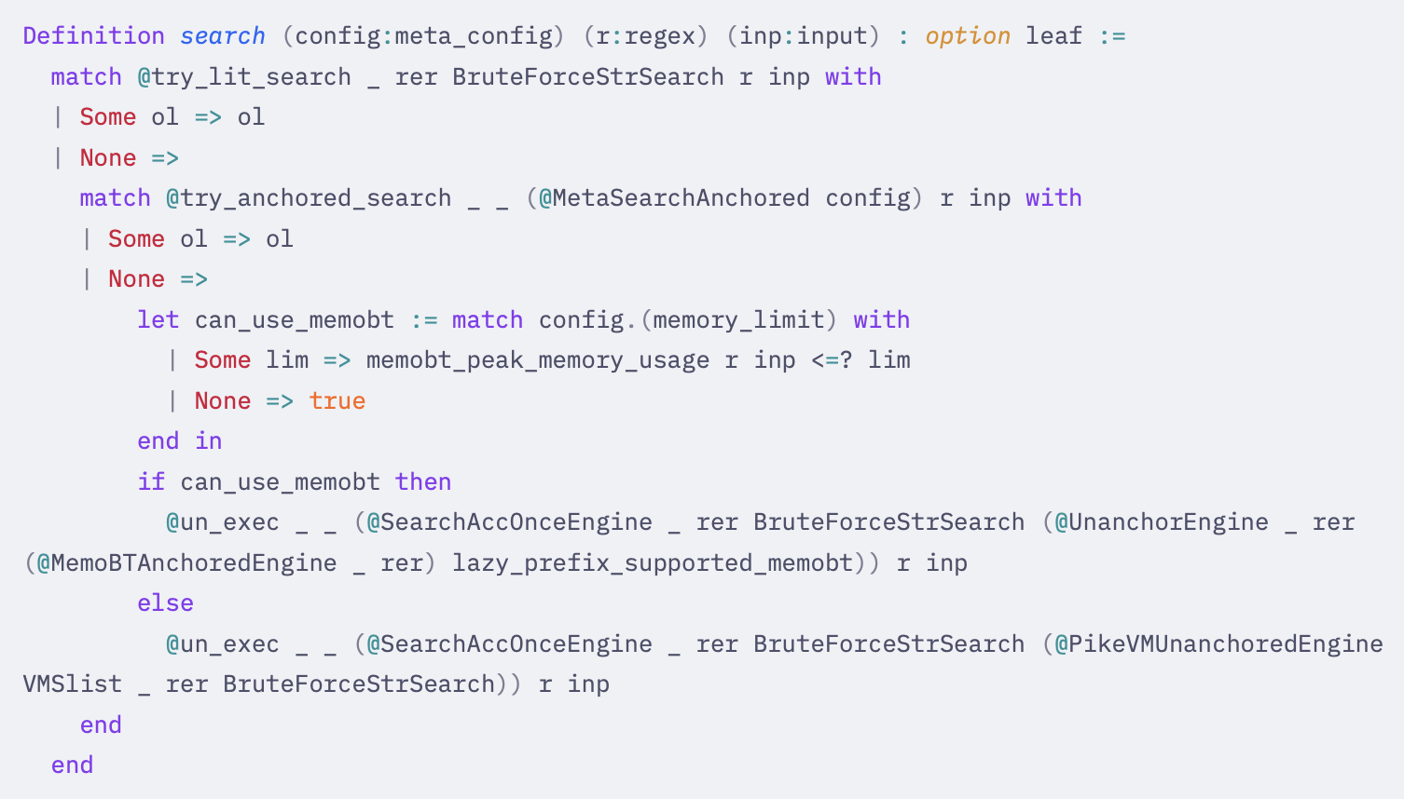
Meta engine | 32 of 36
Engine/Meta/Meta.v#98-102
A complete verified realistic matching function
Notes:
Our algorithms have functional version proven faithful to the small step semantics

Slide 35
Conclusion
Conclusions | 33 of 36

Slide 36


Conclusion
Future work
Conclusions | 34 of 36
Proved the correctness of an unanchored PikeVM utilizing prefix acceleration
Novel extension through filtering
Proved the correctness of a Meta engine
Anchored searches
Impossible regexes
Black-box prefix acceleration
Realistic regex matching algorithm
Everything formalized in Rocq
Contribute filtering to rust regex
Back optimizations
Multiple literals
More regex engines
LazyDFA
One-pass DFA
Valorization: lookarounds in PikeVM

Slide 37

Documentation
Conclusions | 35 of 36
Report
This presentation
Progress reports
Permalinks for:
Rocq formalization
Rust regex implementation
Regex benchmarks
Frequency analysis
Everything needed to reproduce the results
https://github.com/shilangyu/pikevm-systemf
Notes:
I have put a lot of care into making everything accessible and reproducible

Slide 38
Merci
Merci | 36 of 36

